Slide 1

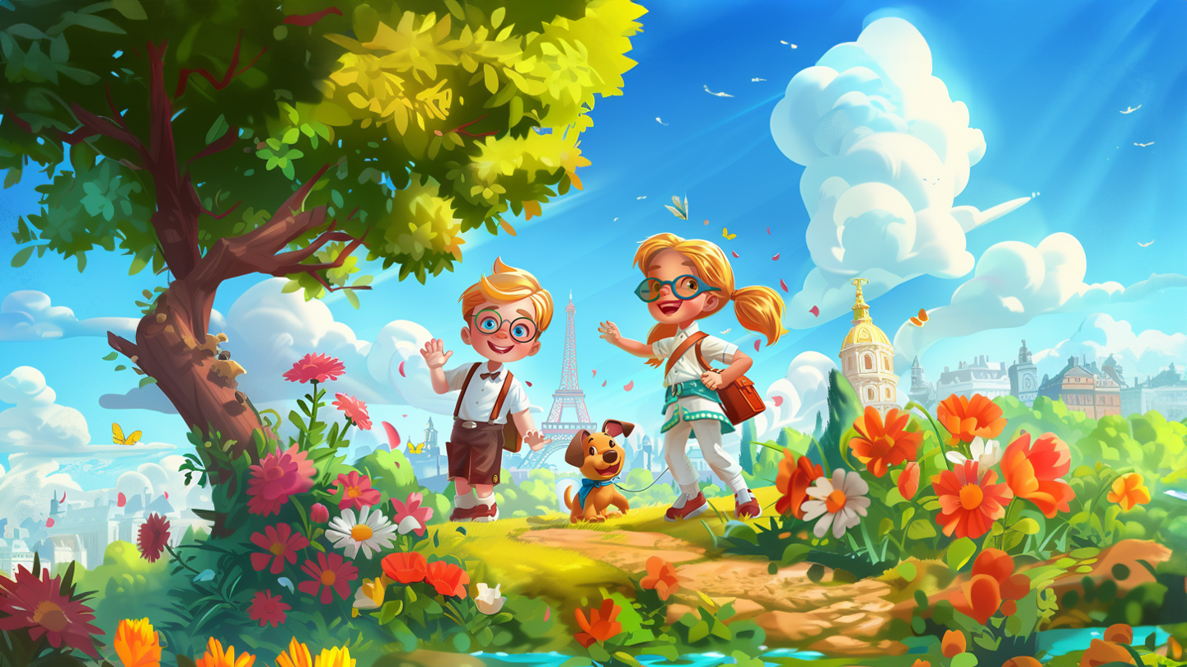

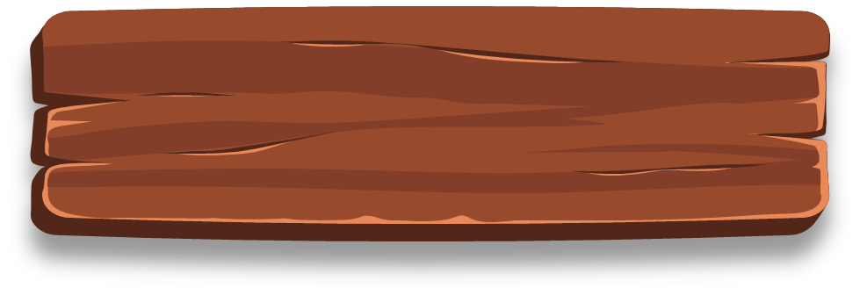
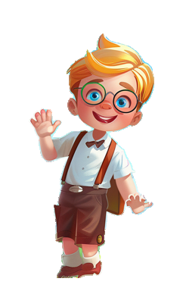
True or
False
Knowledge Quest
Can you tell what's true and what's not?
Start

Slide 2

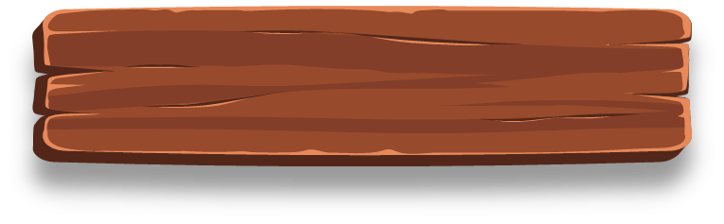
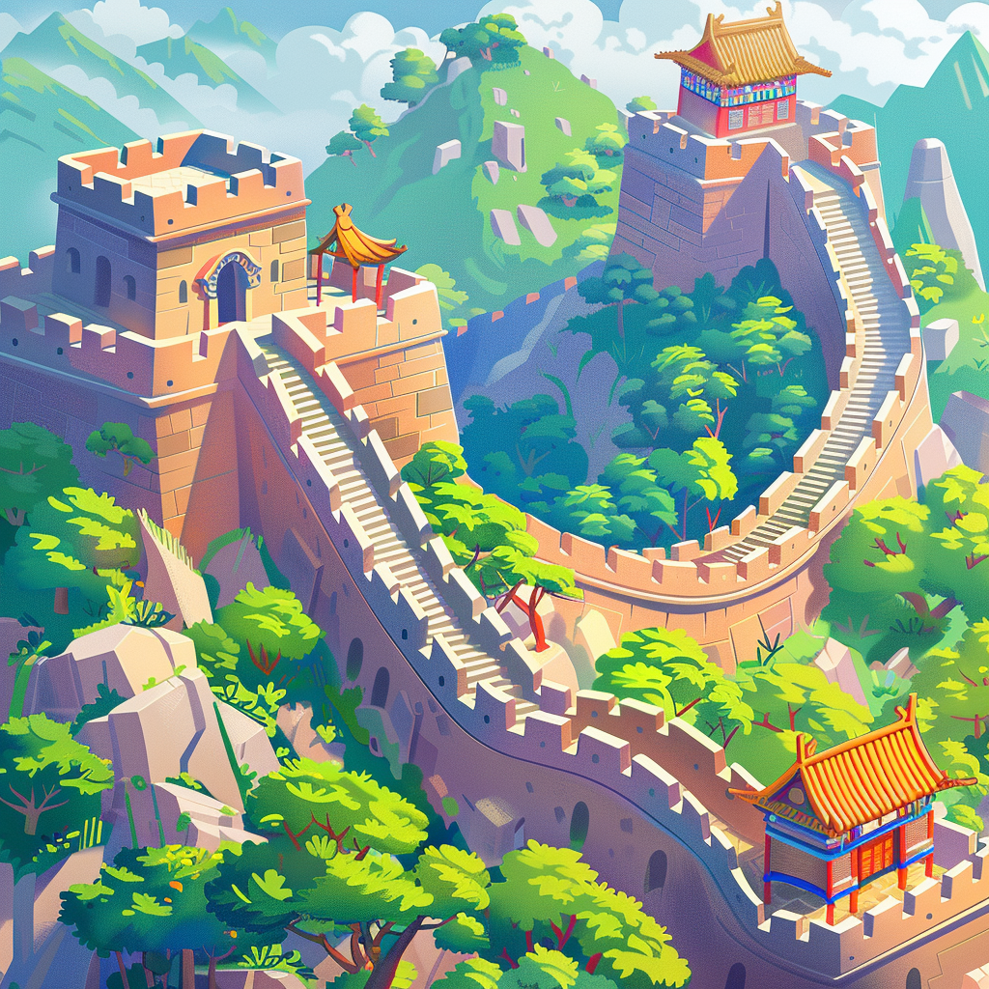
Question 1
The Great Wall
of China can be seen
from space
True
False

Slide 3
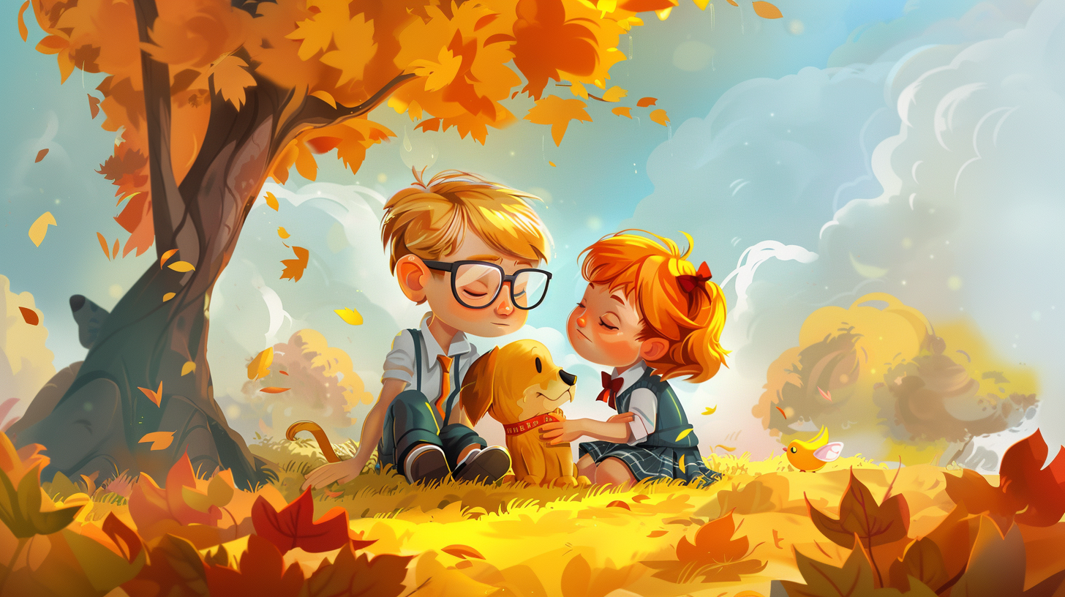

Incorrect
Please try again

Slide 4
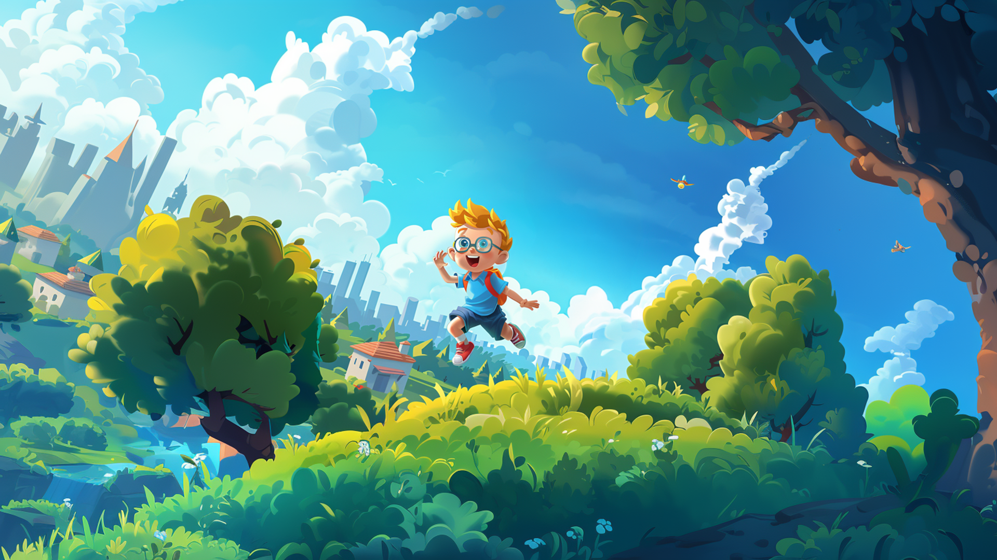
Correct
Please go to
the next question.

Slide 5
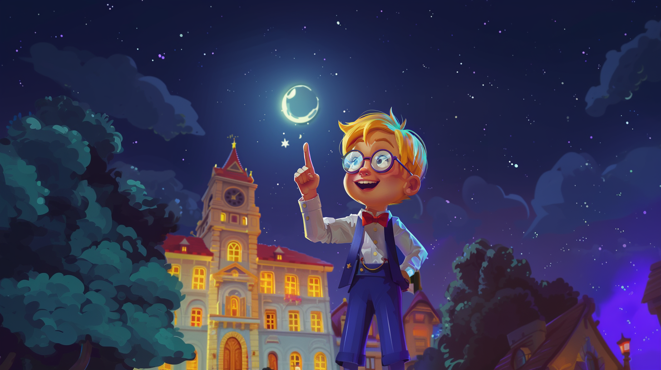
False
Explanation
This statement is false. While the Great Wall of China is impressive, it is not visible from space with the naked eye.

Slide 6

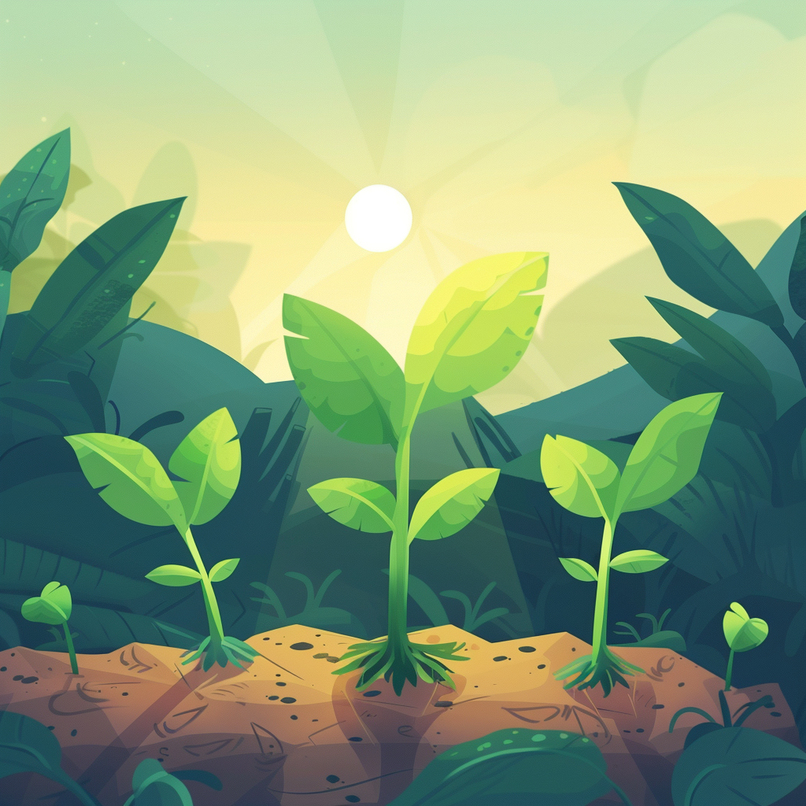
Question 2
Plants need
sunlight to grow.
True
False

Slide 7
Incorrect
Please try again

Slide 8
Correct
Please go to
the next question.

Slide 9
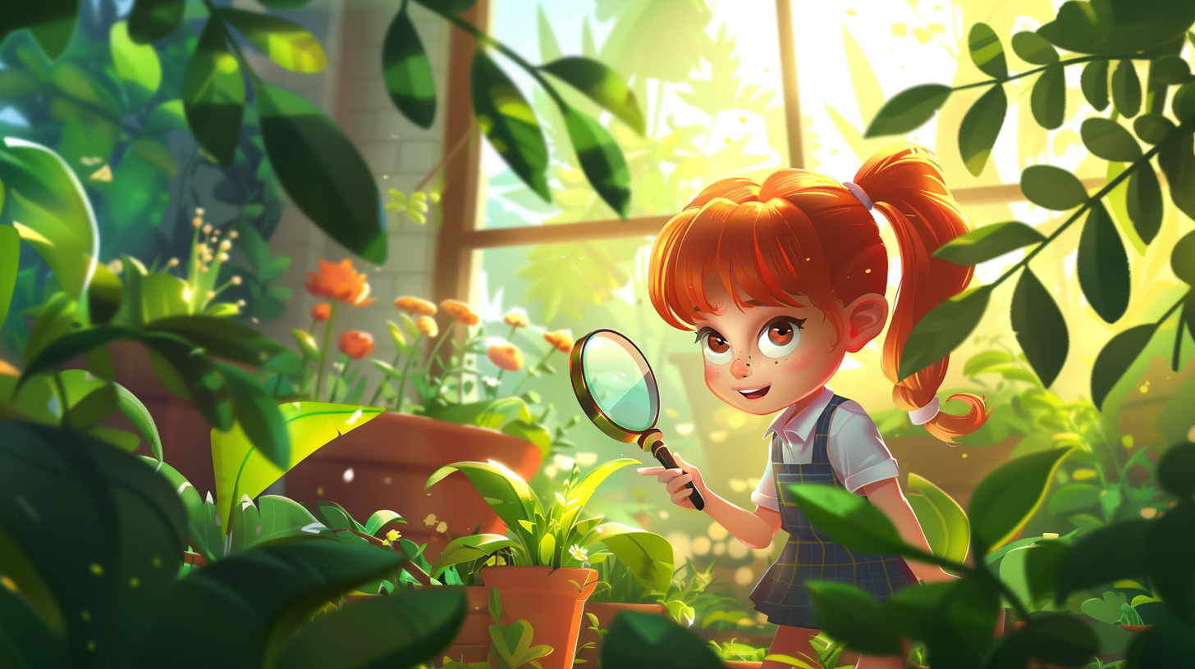
True
Explanation
This statement is true. Sunlight is essential for photosynthesis, the process by which plants make their food.

Slide 10

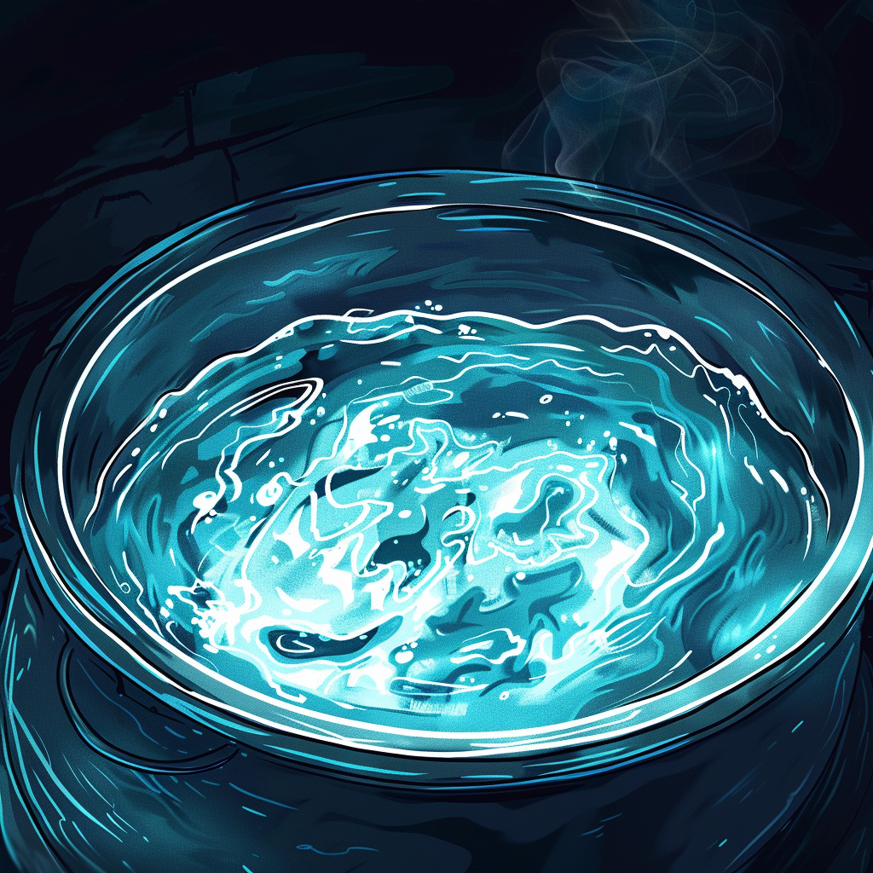
Question 3
Water boils at
100 degrees Celsius.
True
False

Slide 11
Incorrect
Please try again

Slide 12
Correct
Please go to
the next question.

Slide 13
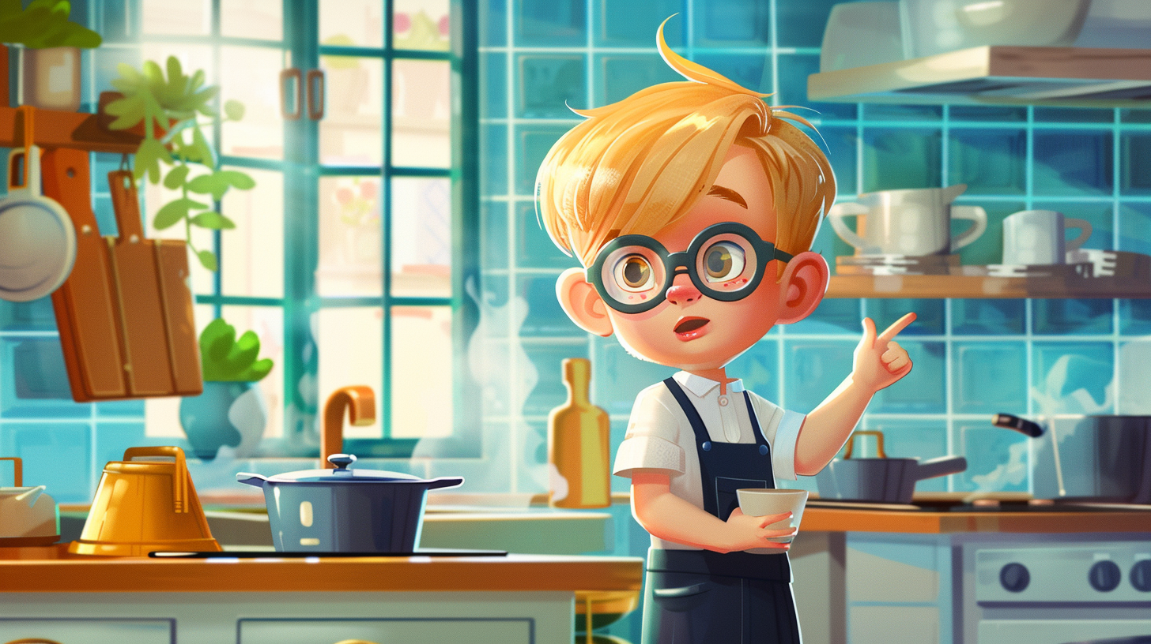
True
Explanation
This statement is true. Water boils at 100 degrees Celsius (212 degrees Fahrenheit) at sea level.

Slide 14

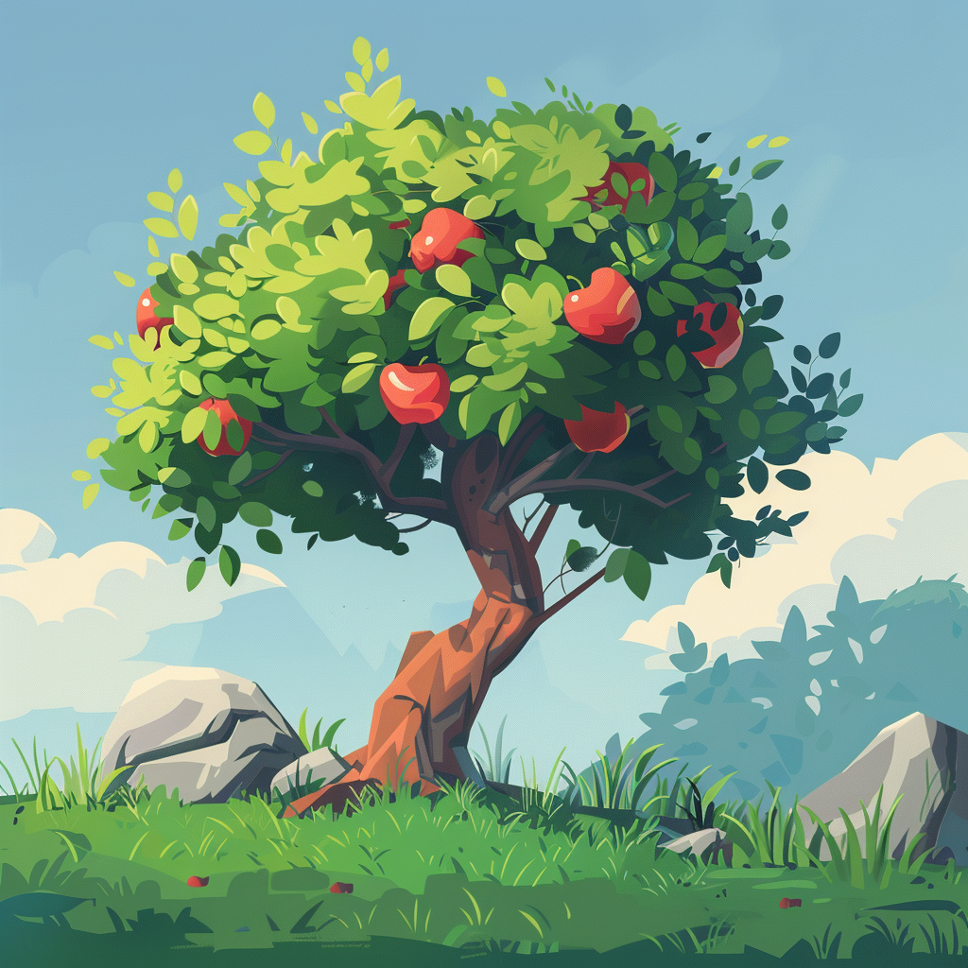
Question 4
Apples grow
on trees.
True
False

Slide 15
Incorrect
Please try again

Slide 16
Correct
Please go to
the next question.

Slide 17
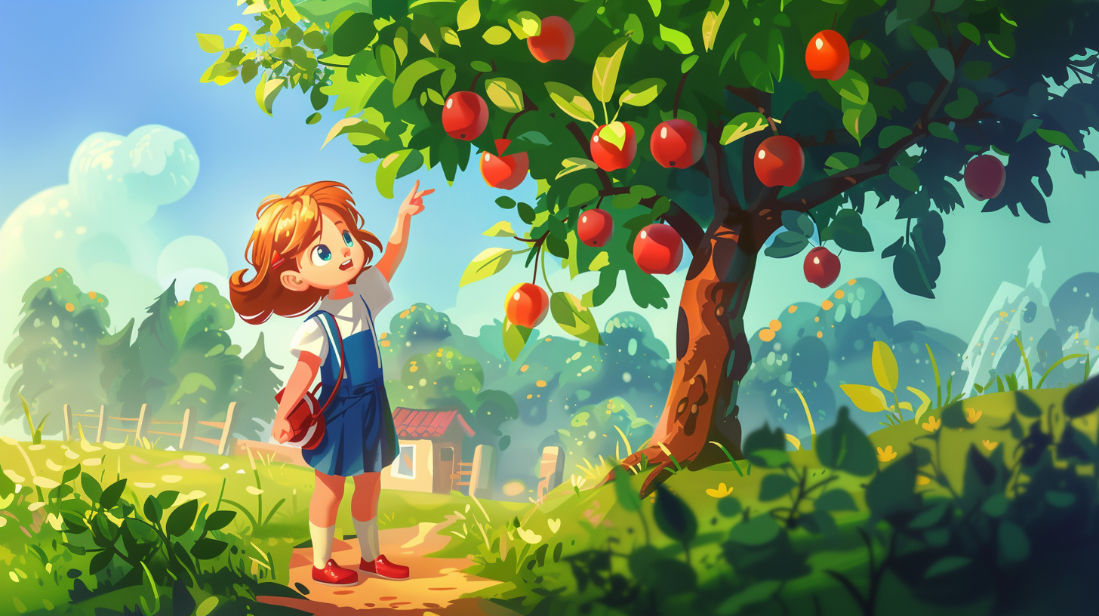
True
Explanation
This statement is true. Apples are fruits that grow on apple trees.

Slide 18

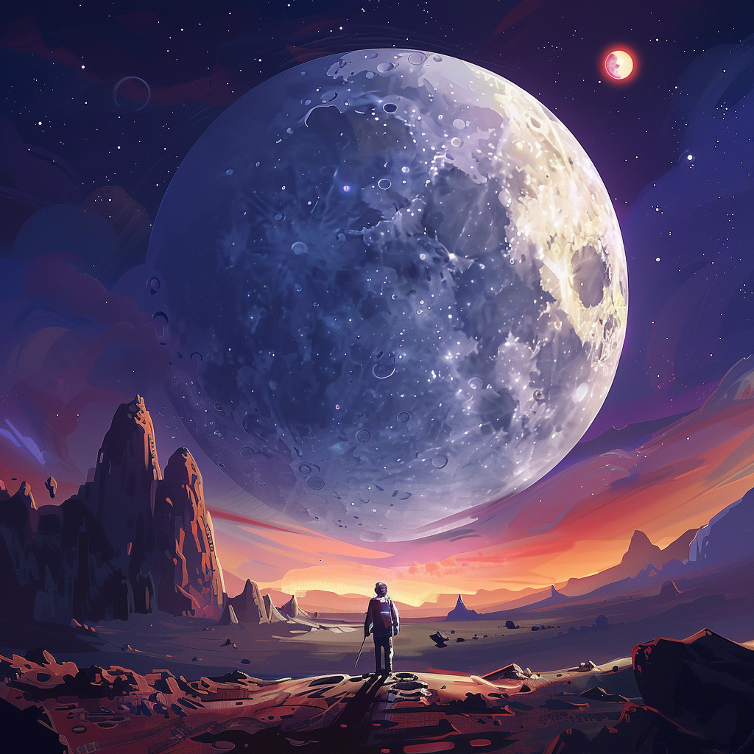
Question 5
The Moon is
bigger than the Earth.
True
False

Slide 19
Incorrect
Please try again

Slide 20
Correct

Slide 21
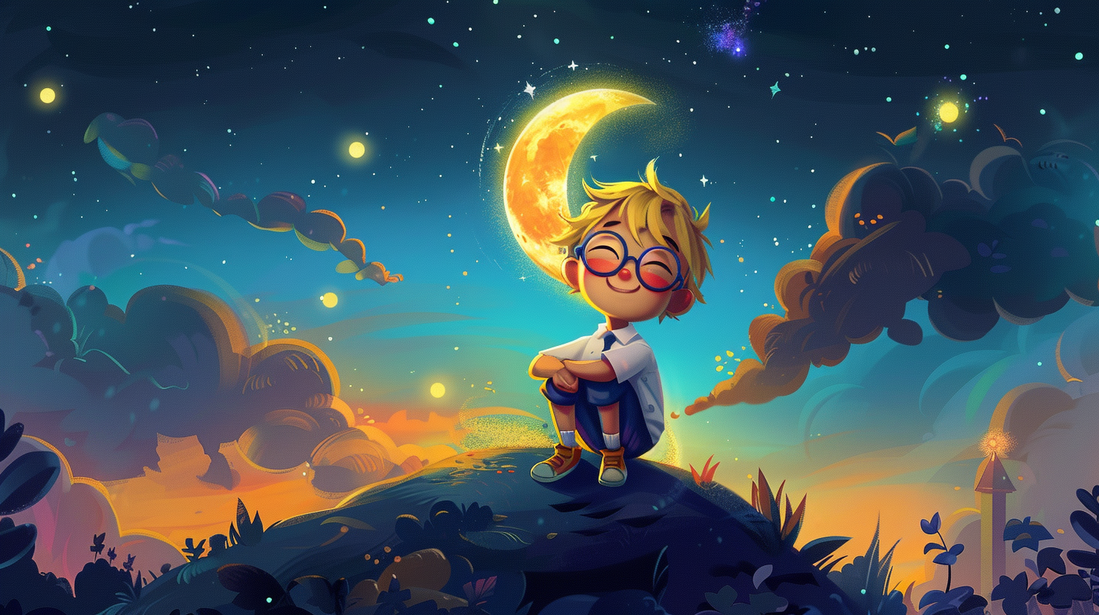
False
Explanation
This statement is false. The Earth is much larger than the Moon. The Moon is Earth's only natural satellite.

Slide 22
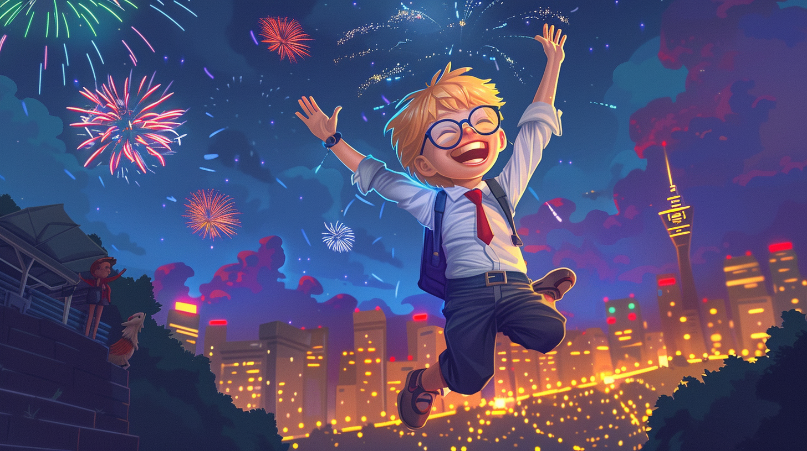
You did it!
Give yourself a pat on the back. Keep curious and keep learning!

